Slide 1

DriverPass System Analysis
Bryce Jensen
Notes:
[No speaker notes required for this slide.]

Slide 2
System Requirements
Functional Requirements
Encryption
Reports
Site Activity
Invoice
Car Activity
Non-Functional Requirements
Uptime
99.95%
Should Be Intuitive
Easy to Use
Notes:
Functional
The system shall encrypt sensitive user data, such as passwords, using industry-standard encryption algorithms.
The system shall generate reports on site activity, financial invoices, and car activity.
Non-Functional
The system shall be available a minimum of 99.95% of the time. Downtime will be minimal. This is less than 1 full day of downtime per year.
The system shall have a layout that is intuitive and easy to use for all users.

Slide 3
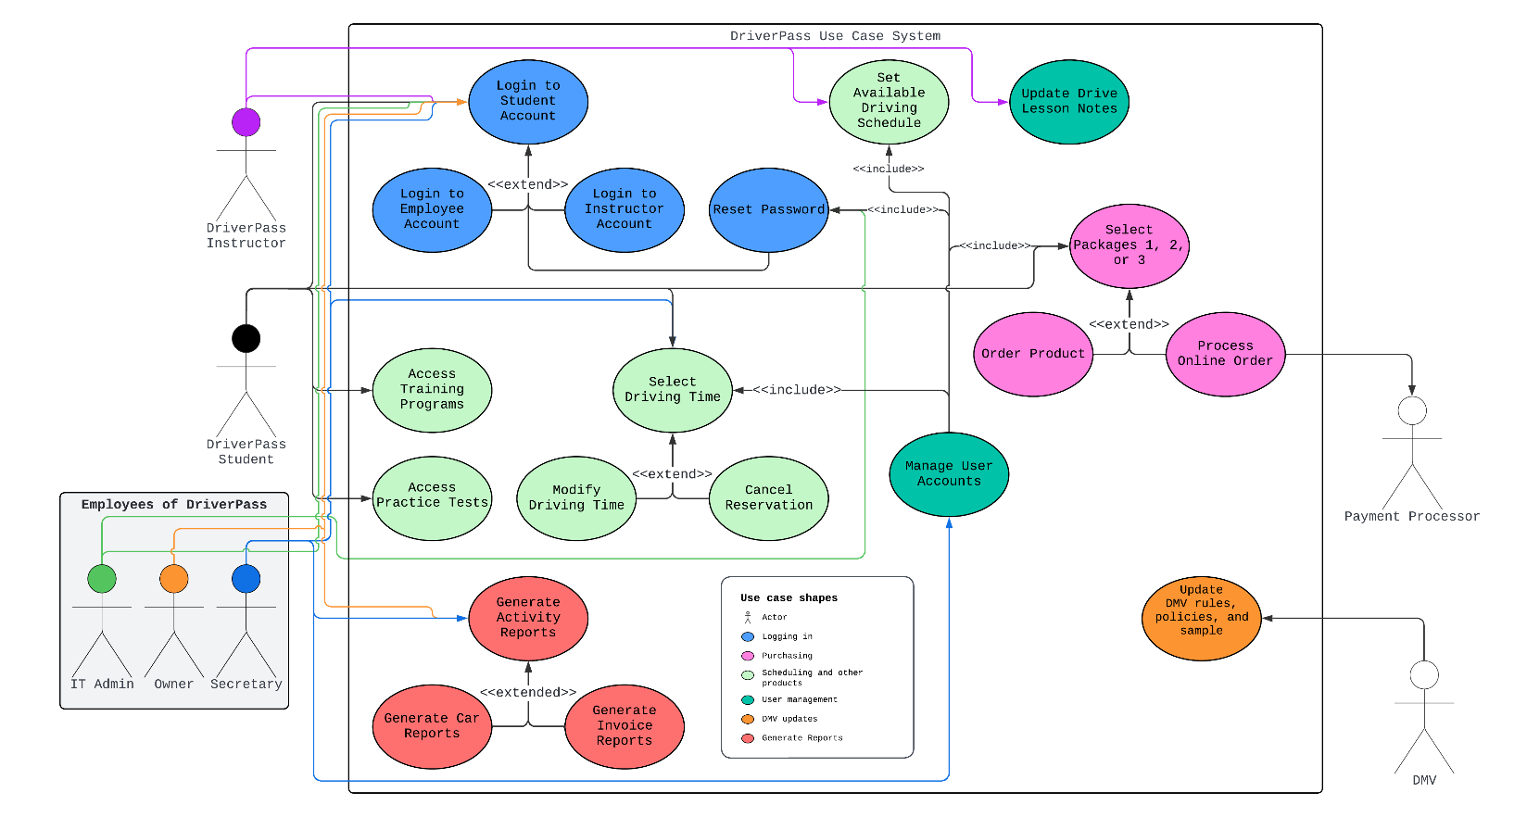
Use Case Diagram
Notes:
This is a use case diagram I created of the DriverPass system. Different colors represent the different parts of the system. Each ellipse shape is an action that can be done in the system. Following the arrows from each of the people (or users) outside of the system will show the order of potential things they can do.
The people, or groups that will interact with the system are the employees of DriverPass, the IT admin, Owner, and Secretary; the DriverPass Student; the DriverPass Driving Instructor; the payment processor, and the DMV for updating rules and policies.
The main groups of use cases, or parts of the system that do something, have been listed in the “Use case shapes” area. They are logging in, purchasing, scheduling and the other products that can be purchased, user management, DMV updating, and report generation.
I accounted for DriverPass’ needs by allowing the DriverPass employees access to scheduling appointments and driving schedules, purchasing packages on student’s behalf, and resetting passwords. I also included the three different packages they wanted in the initial release. The owner and secretary roles can also generate reports for activity on the site, reports on the cars they have, and invoice reports for finances.

Slide 4

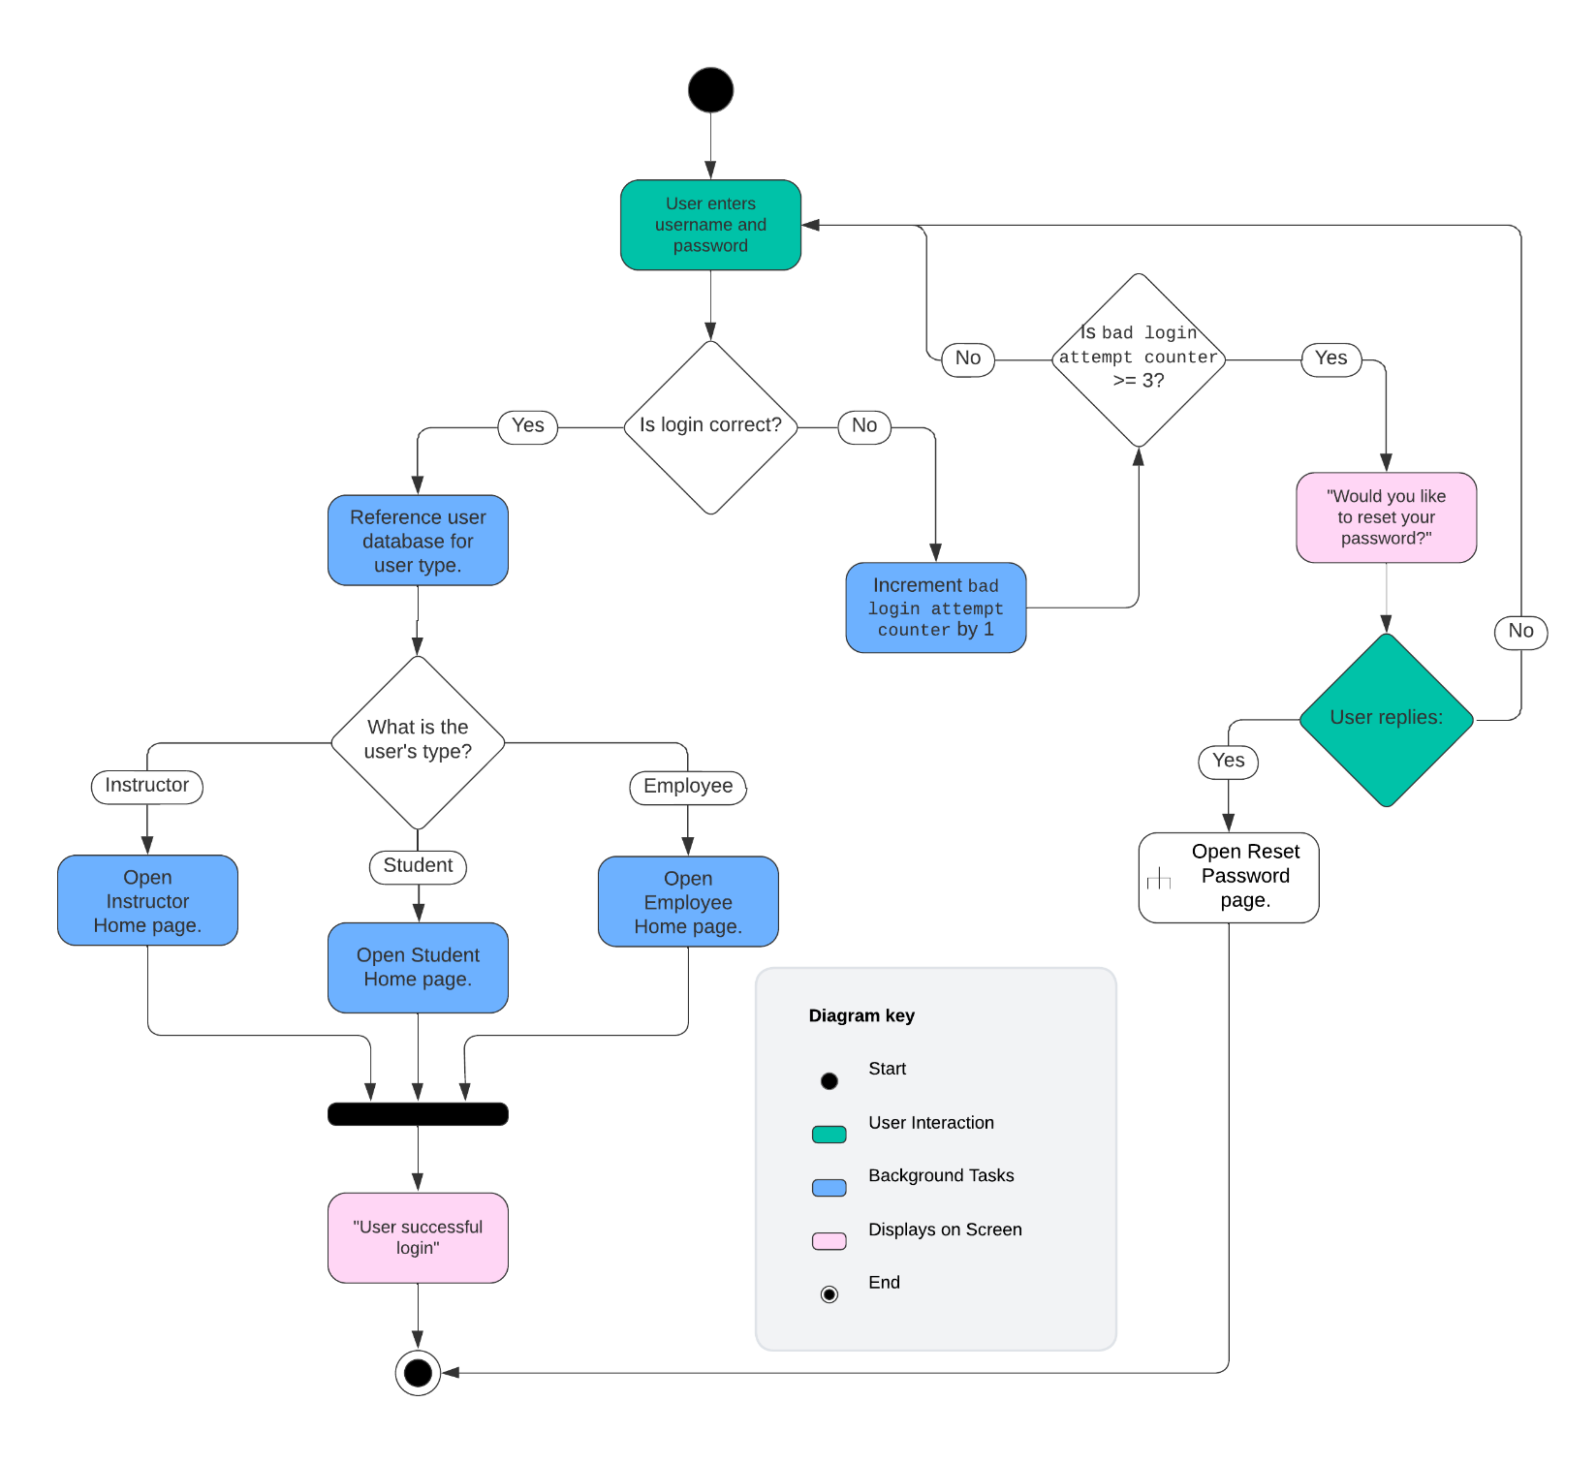
Activity Diagram for Logins
Notes:
I am breaking down the process of logging into the DriverPass site. Green boxes indicate a user interacting with the system, Blue are background tasks, and Pink are on-screen messages.
Here are the steps. I will do my best to hit everything.
User enter their username and password. **This assumes that they have already created an account. However, if the email isn’t recognized, it can prompt the user to create an account.** (Proceed to step 2.)
It will reference the database to verify if the login is correct. (If yes, 3a. If no, 3b.)
3a. References the database for the user type, employee, student, or instructor. (If Instructor, 4aa. Student, 4ab. Employee, 4ac.)
3b. Increments the bad login counter by 1. This keeps track of how many bad login attempts there have been during this session. (Step, 4b)
4aa. Opens the instructor page. (Step 5a.)
4ab. Opens the student page. (Step 5a.)
4ac. Opens the employee page. (Step 5a.)
4b. If the bad login attempt counter is greater than or equal to 3, go to step 5ba. If it is lower, step 5bb.)
5a. This step merges the paths in this branch. And tells the user that it was a successful login.
5ba. Asks the user if they would like to reset their password. (Yes, step 6ba. No, step 6bb)
5bb. User is asked to reenter username and password.
6ba. Takes the user to a new Reset Password page.
6bb. User is asked to reenter username and password.
(Yes, I know this is needlessly complex and presenting it live would be much easier.)
I adhered to DriverPass requirements by including a reset password option. While they didn’t request this specifically, for the different user types I included different login pages. This keep everything nice and separate for the different levels of user access they want to include in the DriverPass system.

Slide 5
Security
User Access Restrictions
Encryption
Notes:
There are different users, they only have access to the parts of the system that they need. For example, a student isn’t going to need access to creating new user accounts or access to the reports. Only the IT admin can create new accounts, and only the secretary and the owner can run reports.
All user data in encrypted. This means that there is no way to access their information without a password. For example, credit card information and personal addresses will be kept a secret from anyone who doesn’t need to know them.

Slide 6
System Limitations
Data Limitations
Chat and Communication
Notes:
Due to this system running in a browser, it is not going to be able to run massive amounts of data in the same way that a dedicated program on your computer might be able to. It should never need to, but it should be noted.
I have not accounted for any sort of chat feature between students, instructors, or employees (customer service). All communication will need to be handled by a third party or over the phone. In the case of a third party, a link to open that service would be recommended.

